Slide 1
MIS775 INVESTMENT PORTFOLIO OPTIMISATION
PREPARED BY BA HUY HOANG LE
STUDENT ID: S22309594

Slide 2
PRELIMINARY WORK

Slide 3
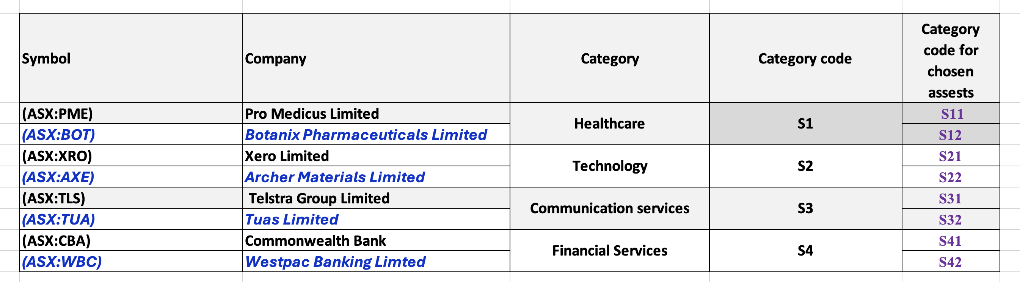
STOCK SELECTION
Important note for the report – Dividends paying stock
Pro Medicus Limited (ASX:PME) – S11
Telstra Group Limited (ASX:TLS) – S31
Commonwealth Bank of Australia (ASX:CBA) – S41
Westpac Banking Limited (ASX:WBC) – S42

Slide 4
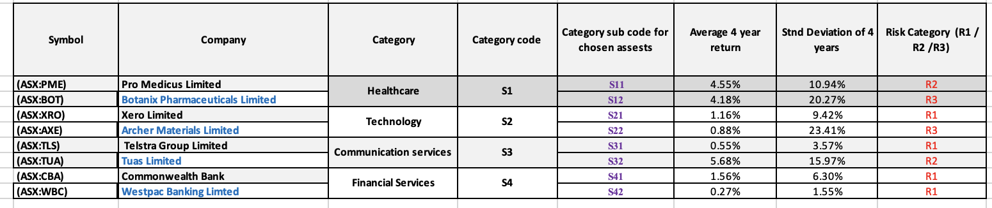
RISK CATEGORISATION
The risk of each stock is calculated using the standard deviation (s) from the monthly rate of return of the respective stock.
R1 (Low risk) | Up to 10.00%
R2 (Medium risk) | Between 10.00% to 20.00%
R3 (High risk) | Above 20.00%

Slide 5
LINEAR PROGRAMMING OPTIMISATION MODEL
Conceptual Model
High-risk stocks limit
Average expected return of each stock
Priority for Low-risk stocks
Sectors allocation
Maximised optimal expected return
Allocated proportion of each stock
Minimum allocation per stock
Total investment sum
Fixed inputs (Constants)
Decision variables (inputs)
Dividend stocks allocation
Decision variables (inputs)
Calculated vairables

Slide 6
LINEAR PROGRAMMING OPTIMISATION MODEL
Defining Variables
Let the proportion of total investment allocated to each stock to be xi, where i = 1, 2,.., 8
x₁ = proportion of investment in Pro Medicus Limited (ASX:PME)
x₂ = proportion of investment in Botanix Pharmaceuticals Limited (ASX:BOT)
x₃ = proportion of investment in Xero Limited (ASX:XRO)
x₄ = proportion of investment in Archer Materials Limited
x₅ = proportion of investment in Telstra Group Limited
x₆ = proportion of investment in Tuas Limited (ASX:TUA)
x₇ = proportion of investment in Commonwealth Bank (ASX:CBA)
x₈ = proportion of investment in Westpac Banking Limited (ASX:WBC)
Objective Function
MaxZ = 4.55%*x1 + 4.18%*x2 + 1.16%*x3 + 0.88%*x4 + 0.55%*x5 + 5.68%*x6 + 1.56%*x7 + 0.27%*x8

Slide 7
LINEAR PROGRAMMING OPTIMISATION MODEL
Constraints
Constraint Requirement | Mathematical Function
High-risk assets shouldn’t exceed 15% of the portfolio | x₂ + x₄ ≤ 0.15
The lowest-risk assets should receive the highest allocation of investments compared to all other risk categories | -x₁ – x₂ + x₃ – x₄ +x₅ – x₆ +x₇ +x₈ ≤ 0
Each sector must have a minimum of 15% invested. One sector to have at least 20% invested | x₁ + x₂ ≥ 0.15 x₃ + x₄ ≥ 0.15 x₅ + x₆ ≥ 0.3 x₇ + x₈ ≥ 0.4
The minimum investment in each asset should be 5% | x_{1,2,…, 8} ≥ 0.05
Total investment sum | x₁ + x₂ +…+ x₇ + x₈ = 1.00
At Least 40% of the Portfolio must be in Dividend stocks | x1 + x5 + x7 + x8 ≥ 0.4

Slide 8
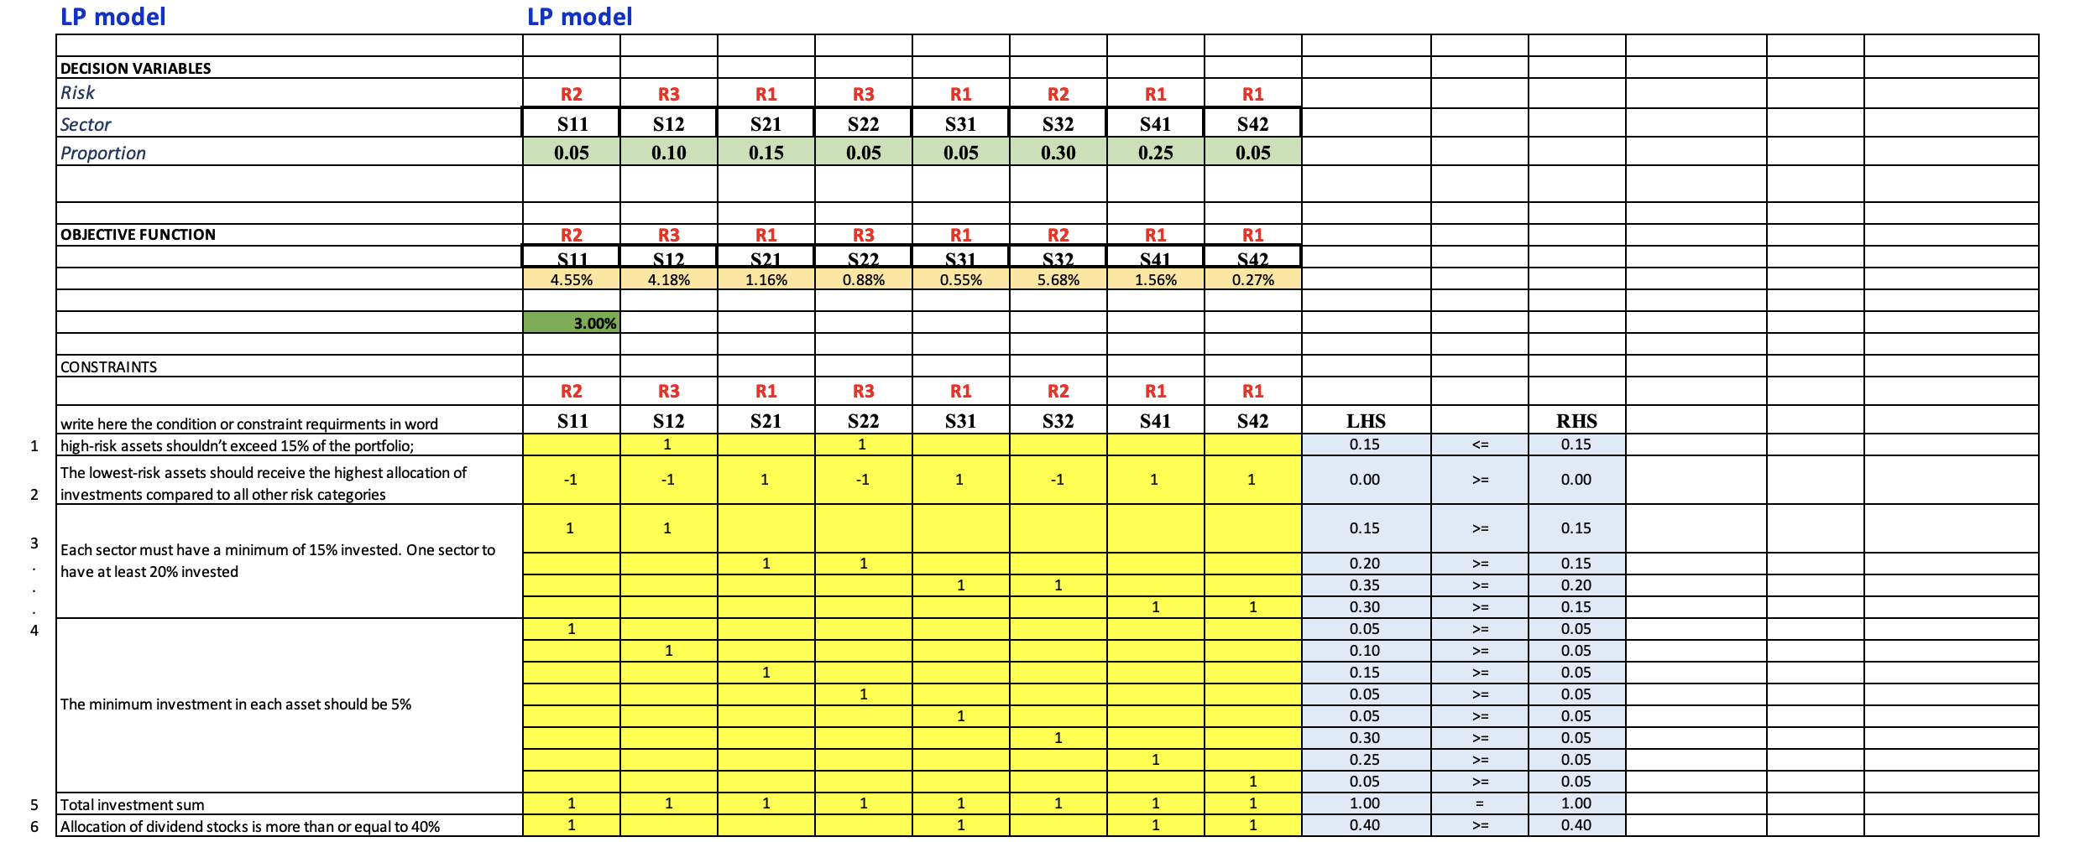
LINEAR PROGRAMMING OPTIMISATION MODEL
Translating constraints into Excel

Slide 9
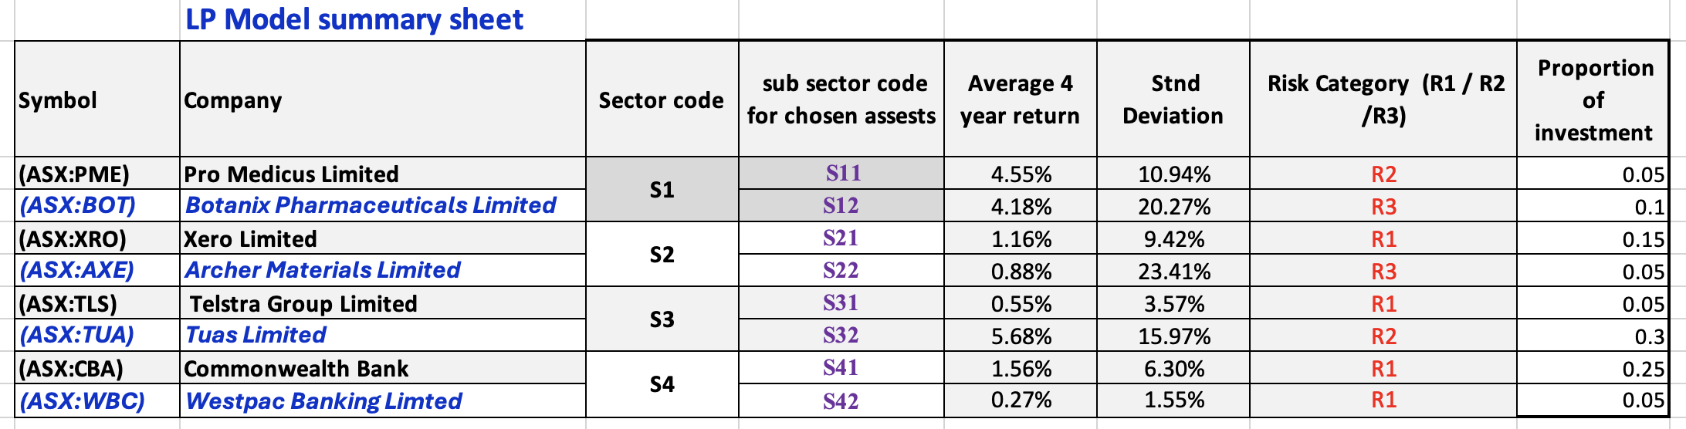
LINEAR PROGRAMMING OPTIMISATION MODEL
Summary of Results
Optimal Value 3.00% (2 d.p)

Slide 10
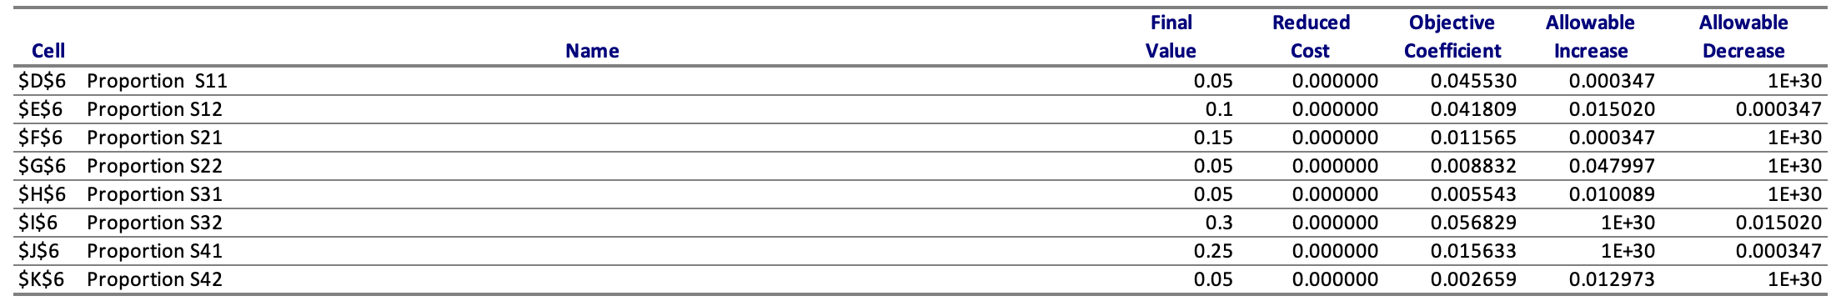
LINEAR PROGRAMMING OPTIMISATION MODEL
Sensitivity Analysis - Variables
Reduced cost = 0 (for all stocks)
All assets included in the portfolio are optimal. No assets can be removed or replaced by any other assets with a better return without violating any of the constraints or reducing the expected return of the portfolio.
Objective Coefficient
Proportion of Tuas Limited (ASX:TUA) - S32 has the highest expected return contribution (5.68%) among all stocks in the portfolio, so it is likely the most favourable investment looking from a return perspective of the model
Proportion of Telstra Group Limited (ASX:TSL) - S31 has the lowest expected return contribution (0.055%) among all stocks in the portfolio, so it is likely the least favourable investment looking from a return perspective of the model

Slide 11
LINEAR PROGRAMMING OPTIMISATION MODEL
Sensitivity Analysis - Variables
Allowable increases
The following stocks have extremely large allowable increases:
Tuas Limited (ASX:TUA) – S32
Commonwealth Bank of Australia (ASX:CBA) – S41
This means these stocks can tolerate significant rise in return without affecting the optimal allocation, but they are sensitive to small decreases in return of 1.52% and 0.0347%, respectively.

Slide 12
LINEAR PROGRAMMING OPTIMISATION MODEL
Sensitivity Analysis - Variables
Allowable decreases
The following stocks have extremely large allowable decreases:
Pro Medicus Limited (ASX:PME) – S11
Xero Limited (ASX:XRO) – S21
Archer Materials Limited (ASX:AXE) – S22
Telstra Group Limited (ASX:TLS) – S31
Westpac Banking Limited (ASX:WBC) – S42
This means these stocks can tolerate significant drops in return without affecting the optimal allocation. This can be due to the low expected return of these stocks and the low proportions in the final optimal value.

Slide 13
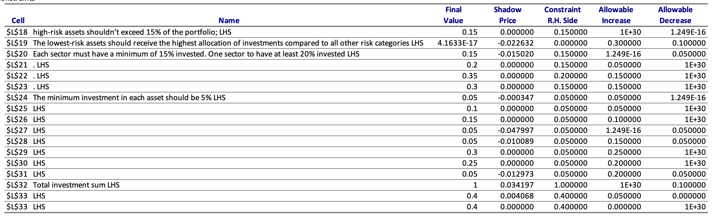
LINEAR PROGRAMMING OPTIMISATION MODEL
Sensitivity Analysis - Constraints

Slide 14
LINEAR PROGRAMMING OPTIMISATION MODEL
Sensitivity Analysis - Constraints
High-risk asset constraint
This is a binding constraint (LHS = RHS = 0.15). This means the portfolio has exactly 15% of high-risk assets (Botanix Pharmaceuticals Limited – S12 and Archer Materials Limited – S22). A very small decrease in the limit can already affect the optimal solution.
Priority for low-risk stock constraint
This constraint is non-binding, even though the LHS is asymptotically 0 and RHS is 0. This means this constraint is not directly limiting the optimal solution, which can be adjusted within the allowable increase up to 30% to the allowable decrease of 10%.
Sector investment constraint
Out of 4 sectors, only the first sector (Healthcare) is a binding constraint (LHS = RHS = 0.15). A minimally increase in this sector allocation can already affect the optimal solution

Slide 15
INTEGER LINEAR PROGRAMMING OPTIMISATION MODEL
Defining Variables
Let: x_{i} = 1 if stock i is selected in the portfolio. x_{i} = 0 otherwise (i = 1, 2,…, 8)
x₁ = investment in Pro Medicus Limited (ASX:PME)
x₂ = investment in Botanix Pharmaceuticals Limited (ASX:BOT)
x₃ = investment in Xero Limited (ASX:XRO)
x₄ = investment in Archer Materials Limited
x₅ = investment in Telstra Group Limited
x₆ = investment in Tuas Limited (ASX:TUA)
x₇ = investment in Commonwealth Bank (ASX:CBA)
x₈ = investment in Westpac Banking Limited (ASX:WBC)
Objective Function
MaxZ = 4.55%* x₁ + 4.18%*x₂ + 1.16%*x₃ + 0.88%*x₄ + 0.55%*x₅ + 5.68%*x₆ + 1.56%*x₇ + 0.27%* x₈

Slide 16
INTEGER LINEAR PROGRAMMING OPTIMISATION MODEL
Constraints
Constraint Requirement | Mathematical Function
A Balanced portfolio of exactly 5 stocks is to be chosen | x₁ + x₂ +…+ x₇ + x₈ = 5.0
The 4 investment sectors must be included | x₁ + x₂ ≥ 1.0 x₃ + x₄ ≥ 1.0 x₅ + x₆ ≥ 1.0 x₇ + x₈ ≥ 1.0
At most one asset from the riskiest group (R3) | x₂ + x₄ ≤ 1.0
At least 2 must be in the least risky group (R1) | x₃ +x₅ +x₇ +x₈ ≥ 2.0
An asset from R3 can be selected only if at least one asset from R2 is selected | x₁ - x₂ – x₄ + x₆ ≥ 0
At Least 2 stocks must be dividend stocks | x₁ + x₅ + x₇ + x₈ ≥ 2.0

Slide 17
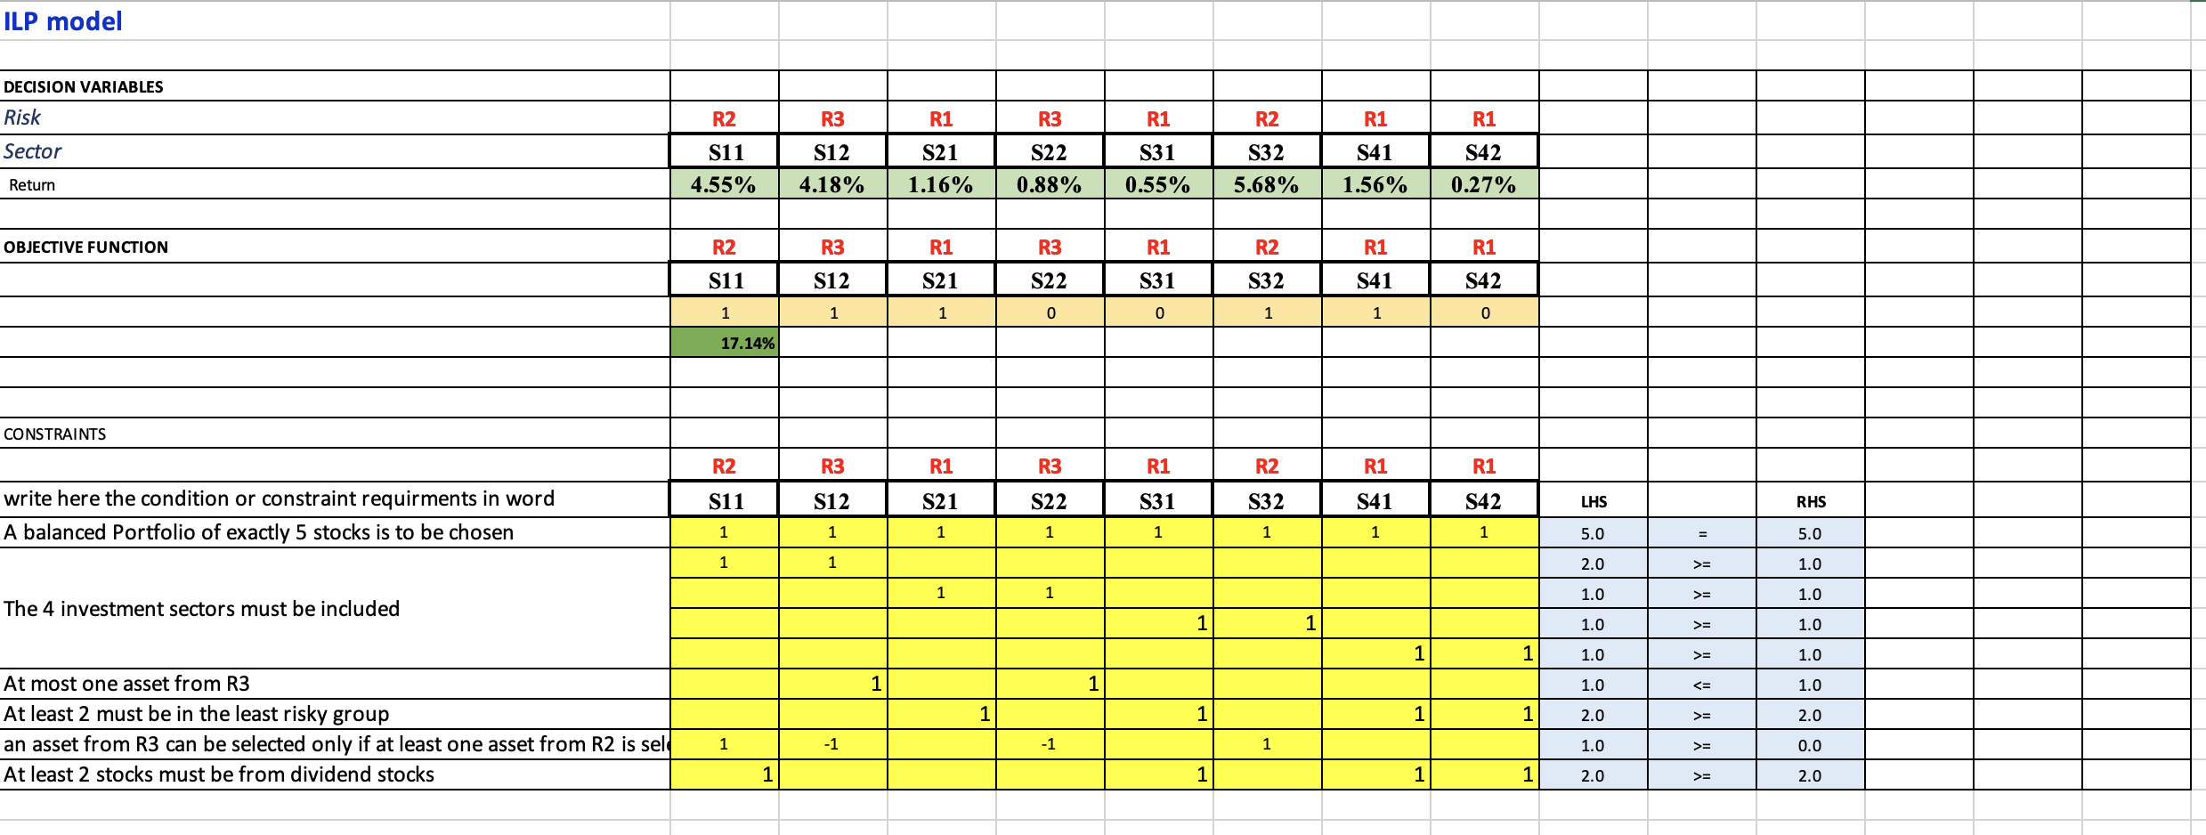
INTEGER LINEAR PROGRAMMING OPTIMISATION MODEL
Translating constraints into Excel

Slide 18
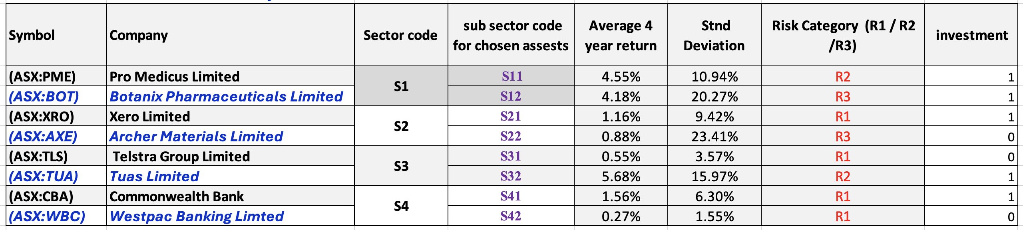
INTEGER LINEAR PROGRAMMING OPTIMISATION MODEL
Summary of Results
Optimal Value 17.14% (2 d.p)

Slide 19
COMPARING OPTIMISATION APPROACHES
Comparison category | Linear Programming | Integer Linear Programming
Objective | Maximising portfolio’s expected return while allocating percentage of each asset | Maximising portfolio by selecting a specified number of assets
Decision variables | Continuous values (%) | Binary (1 means select, 0 means not select)
Output | Allocated investment percentages across all 8 assets bound by constraints | Selected 5 assets in the portfolio
Optimal return & Normalised optimal return | 3.00% (weighted return based on asset allocation) 3.00% | 17.14% 3.428%

Slide 20
FINAL DECISION
The LP model is suitable for allocating money across many options in the portfolio. The ILP model is suitable when choosing a fixed number of assets.
The ILP model is the preferred strategy under this specific case thanks to its higher normalized expected return, even though the LP model allows more flexibility in allocating funds to invest in the stock market

